Slide 1

Third Party Counting file deployment
13/14/15-MAR-2017

Slide 2
Agenda
Perpetual inventory file deployment
Interfacing and Configuration rules
Heinen’s GOLD 5.10/6.0x Migration

Slide 3
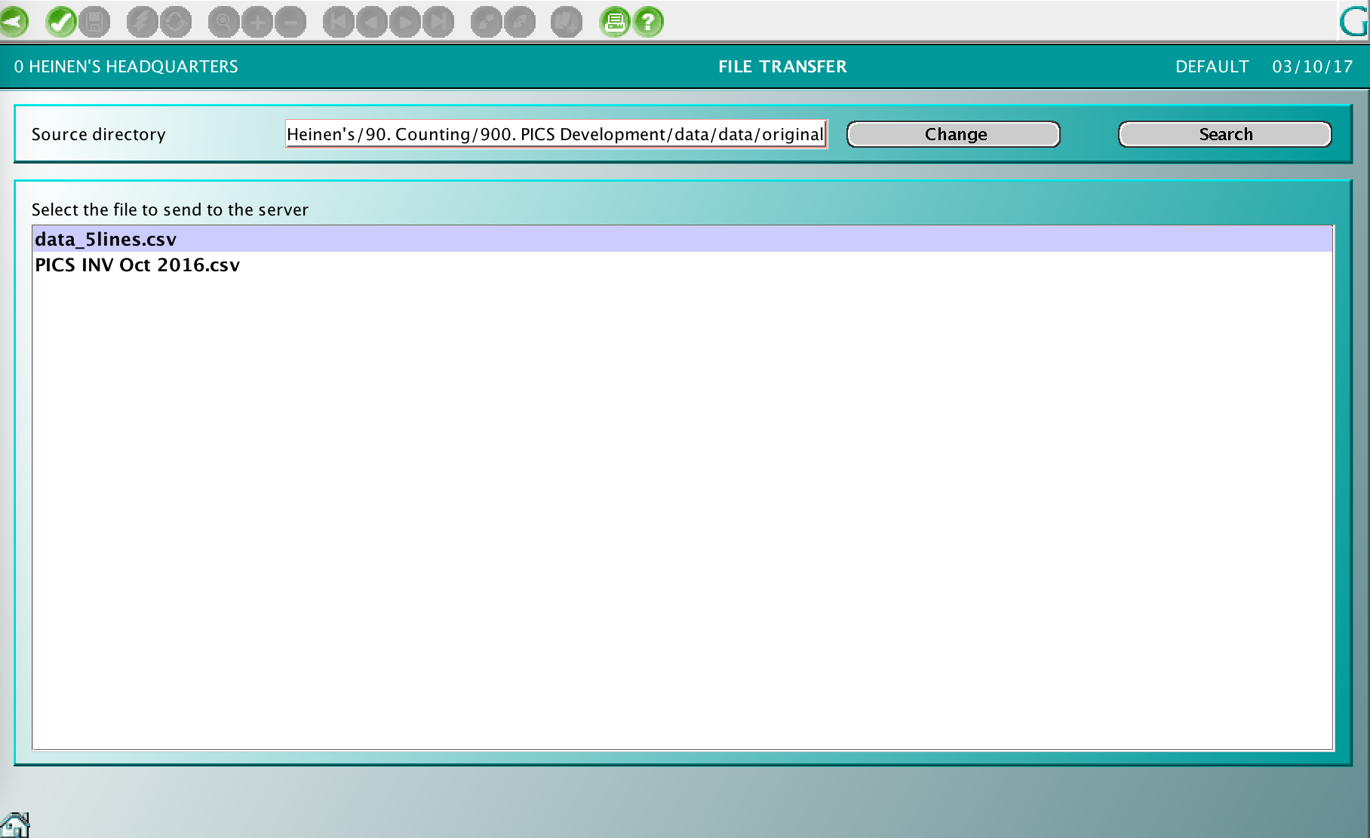
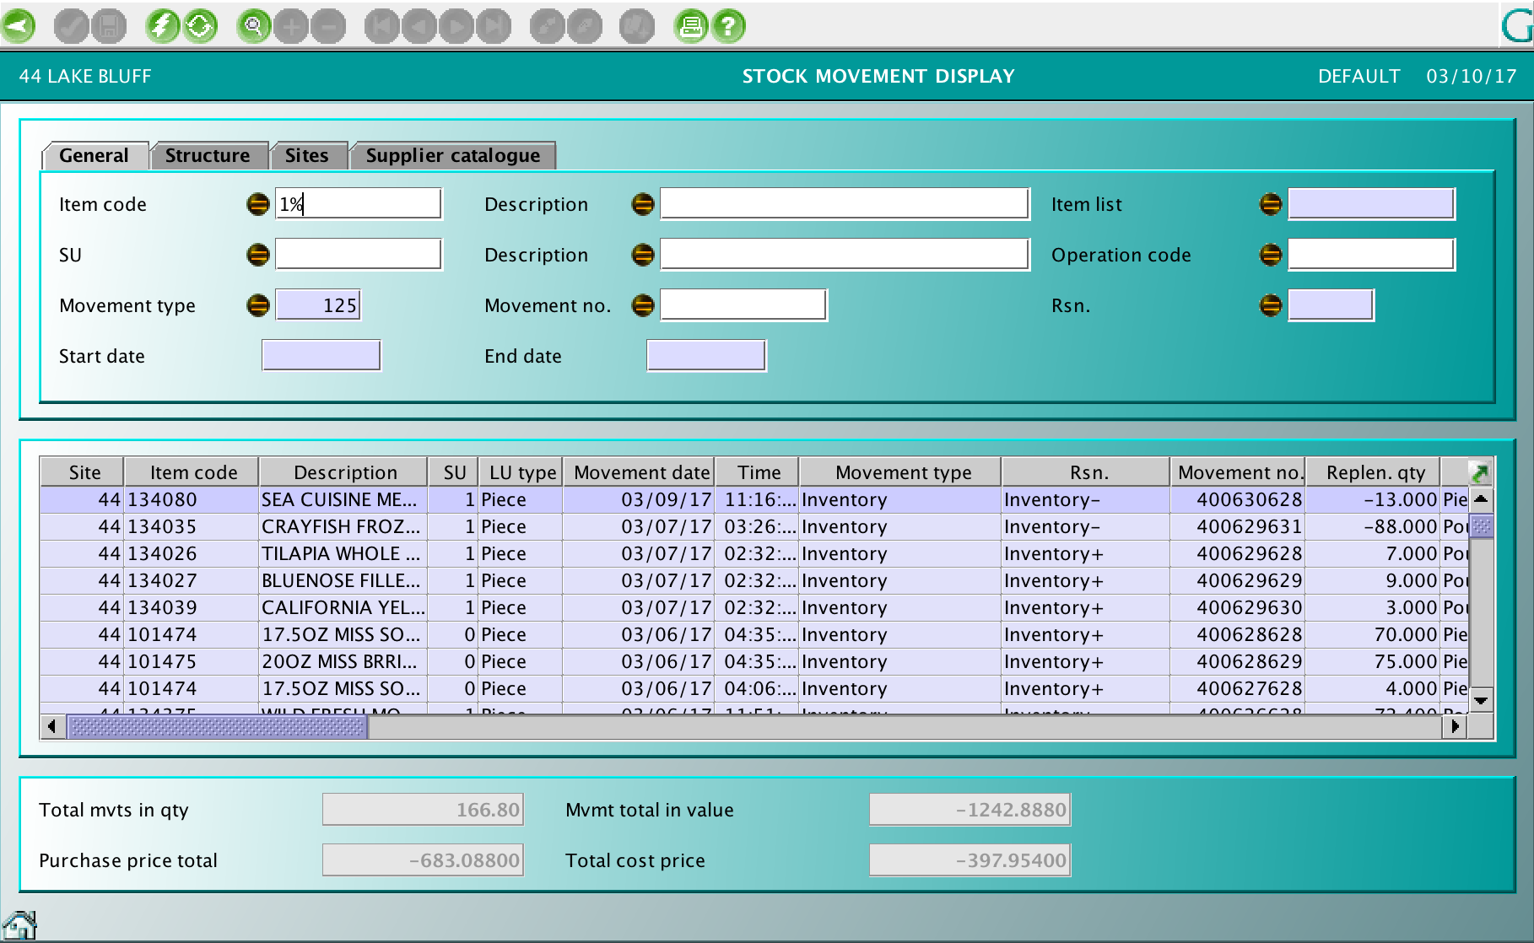
PI : PICS File deployment
PICSINV
INTINV
File downloaded in $GAIA/RECEIVED folder
Batch processing
Integrate file data in staging table
Process the data to GOLD interface table INTINV
Execute the batch integration for cycle count
GOLD
File upload from GOLD using File transfer functionality
The file is downloaded ion $GAIA/RECEIVED folder (folder name and destination are fixed)

Slide 4
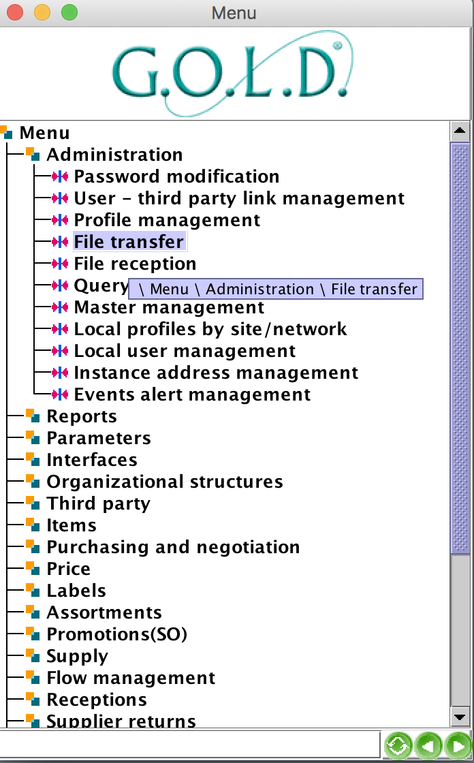
PI : Implementation proposal
File upload from GOLD using File transfer functionality
The file is downloaded ion $GAIA/RECEIVED folder (folder name and destination are fixed)

Slide 5
PI : PICS file data
UPC
Item description
Category/Department/Sub-Department
Item extended cost
Retail
Vendor
Location
Inventory date
Quantity in Inventory

Slide 6
PI : GOLD interfacing requirement
Inventory type needs to be configured with the corresponding condition:
Condition #101 – Init by Interface
The inventory date must be equal to the “launched” batch date (same day)
Cycle count are generating a Stock Update with movement type 125. Inventory
Open points (implemented rules to be reviewed & validated)
The inventory date must be the day of the launched batch.
Inventory type to be defined and will be automatically assigned by interface.
Batch scheduling:
The counting upload should reflect the physical counting (before receiving ? Before sales ?
Only the quantity inventoried are uploaded (no cost change)

